Slide 1
Directional Coupler

Slide 2
By definition.
A directional coupler is a passive four-port network that couples a portion of the power from a main line to a secondary line, based on electromagnetic coupling.
Basic Operations
Input(port1)- It is where the signal enters
Transmitted (Port 2)- The main output where power exists
Coupled (Port 3)- A fraction of the signal is sampled.
Isolated (Port 4)- Ideally, no power should appear(terminated with a matched load)

Slide 3
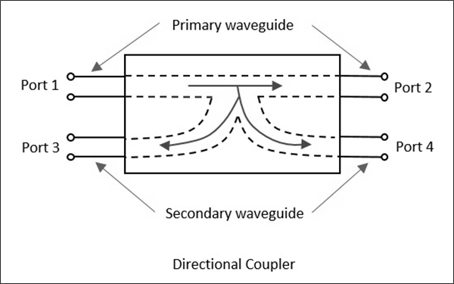
A Diagram of Directional Coupler

Slide 4
It’s working principle.
It works by using the principle of electromagnetic induction, where a signal traveling in the main line induces a signal in the secondary line. The amount of power coupled depends on the coupling factor of the coupler and the physical distance between the lines.
Here's a more detailed explanation:
Four-port Network:
A directional coupler has four ports: a main line (port 1), a coupled line (port 3), and two isolated ports (ports 2 and 4).
Electromagnetic Coupling:
When a signal enters the main line, a portion of the signal is coupled to the coupled line due to electromagnetic interaction between the two lines.

Slide 5
Continue….
Signal Directionality:
The coupler is designed to couple power only in one direction, meaning the signal primarily travels from port 1 to port 3, and port 2 remains relatively isolated from the main line signal.
Coupling Factor:
The coupling factor, which determines the amount of power coupled to the secondary line, depends on the physical characteristics of the coupler, such as the distance between the main and coupled lines.

Slide 6
Application.
Directional couplers are commonly used for;
Signal sampling and Monitoring Purpose: To measure the signal power without interrupting the main transmission. Application: Used in test and measurement systems (e.g., for monitoring output power in transmitters).
Radio frequency (RF) : To detect reflected power caused by impedance mismatches. Application: In antennas and transmission lines, directional couplers help measure the Voltage Standing Wave Ratio (VSWR) and ensure efficient power transfer
Protection of Sensitive Components Purpose: To divert excessive power or reflected waves away from sensitive

Slide 7
Continue……
Phase and Frequency Measurements Purpose: To analyze phase difference or frequency between two signals. Application: Useful in RF signal analysis and synchronization tasks.

Slide 8
Advantages of
Directional Power Sampling:
Allows sampling of signal power in a specific direction (forward or reverse) without disturbing the main signal path.
High Directivity:
Can distinguish between forward and reflected signals with high accuracy.
Passive Operation:
Requires no external power to operate.
Low Insertion Loss
Minimal power loss in the main signal path.

